Slide 1
Deep-fake face detection
Artemii Mysechko
MMAI-2

Slide 2


Task description
Given a dataset of short videos – 40k samples
Recognize fake videos - to train the binary classifier to distinguish real videos from fake ones

Slide 3



Problems
Common CNN – 65.26%
Fake video problems
How to find artifacts efficiently

Slide 4
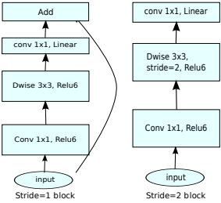
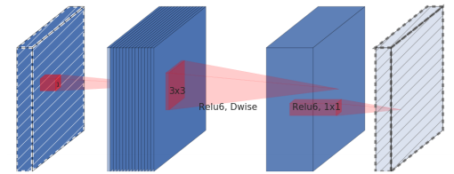
MobileNetV2

Slide 5
Model
№ | Layer | Frames number | Feature map | Size | Activation
Input | Video | 5 | 3 | (185,185) | -
1 | TimeDistributed | 5 | 3 | (185,185) | -
1.1 | MobileNetV2 | 5 | 1280 | (6,6) | -
1.2 | GlobalMaxPool2D | 5 | - | 1280 | -
2 | GRU | - | - | 64 | tanh
3 | Dense | - | - | 1024 | relu
4 | Dropout(0.33) | - | - | 1024 | -
… | Repeat Dense and Dropout layers dividing size by 2 and skip size 256.
9 | Dense | - | - | 64 | relu
10 | Dense | - | - | 2 | softmax

Slide 6
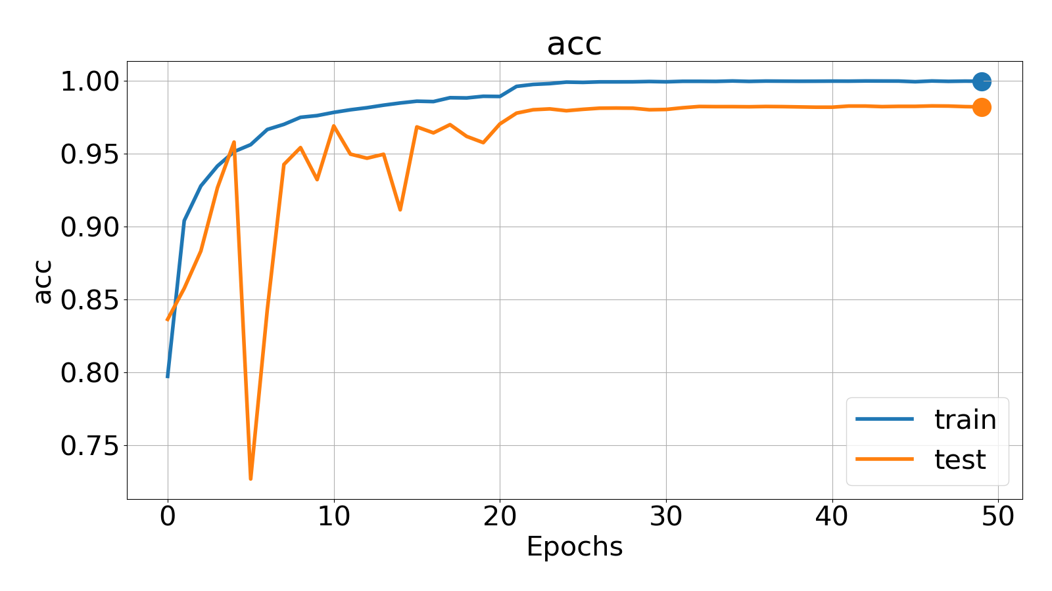
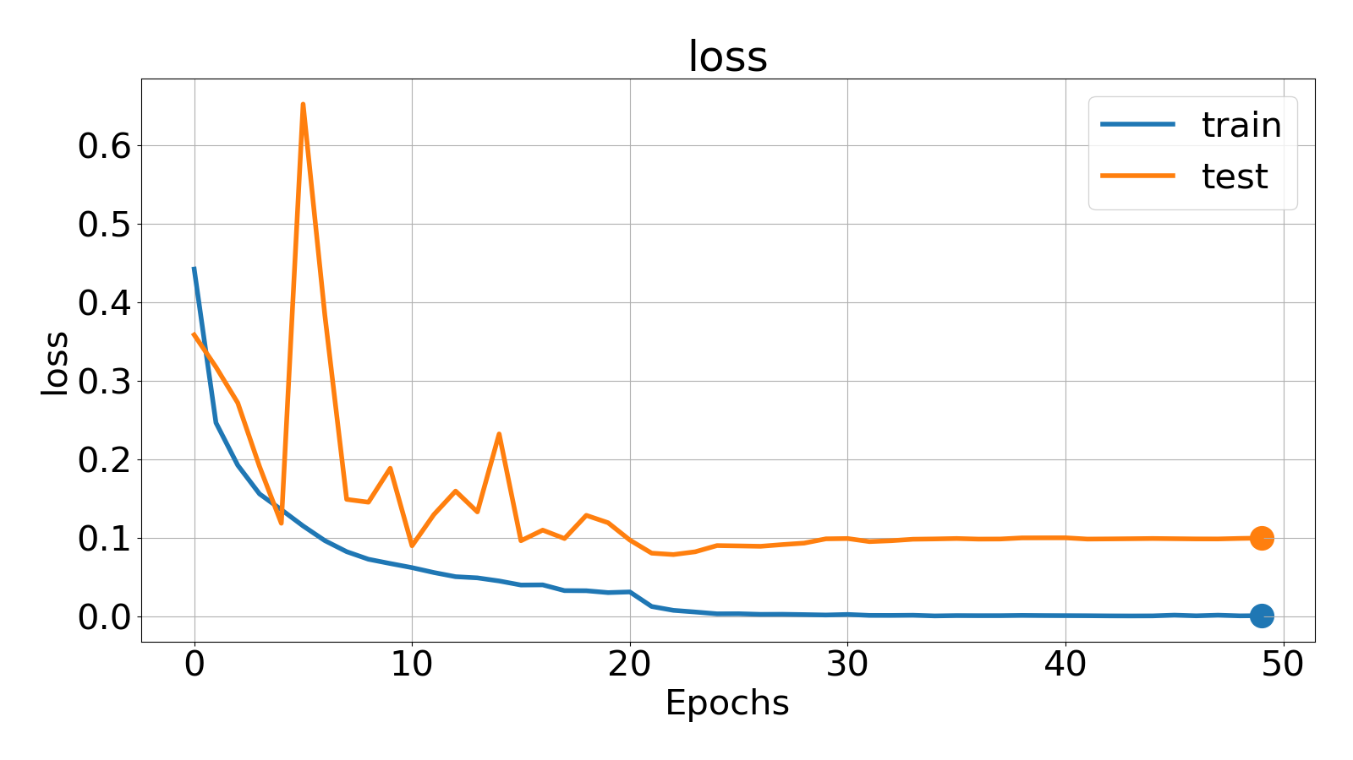
Results
Loss train/test | Accuracy train/test | Parameters | Runtime GPU
0.000825/0.07901 | 0.9998/0.9827 | 3,147,584 | 7 min/epoch

Slide 7
Next steps
Use masks for videos
Own structure for neural network

